Slide 1

QUERY PERFORMANCE IMPROVEMENT USING JAVA PERSISTENCE API
THIAGO ADELINO DE MELO

Slide 2
SUMMARY
Java Persistence API Overview
Relational Paradigm x JPA
Queries with JPA
Example Scenarios

Slide 3

OVERVIEW - JAVA PERSISTENCE API
Hibernate appears in 2003 with the ORM concept.
Simplifies the database operations in the relational paradigma
Oracle incorporates hibernate as part of JSR 220 (EJB 3.0)
After that in 2009 as JSR 317 with the name ‘JPA 2.0’.

Slide 4
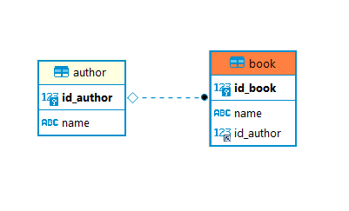
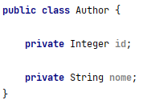
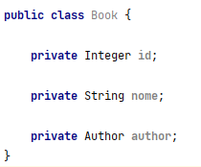
RELACIONAL PARADIGM X JPA
Relationship between Tables x Relationship between Objects (OO):
ORM (Object-relational Mapping)

Slide 5
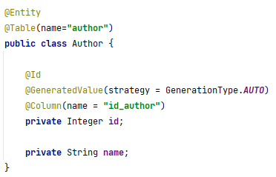
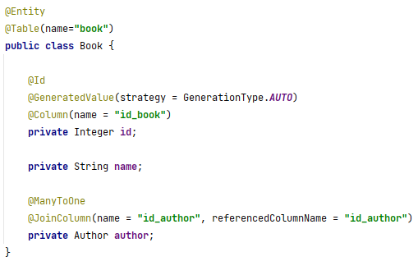
RELACIONAL PARADIGM X JPA
Package javax.persistence.*

Slide 6
RELACIONAL PARADIGM X JPA
Relationship Types
ManyToOne
OneToOne
ManyToMany
OneToMany

Slide 7
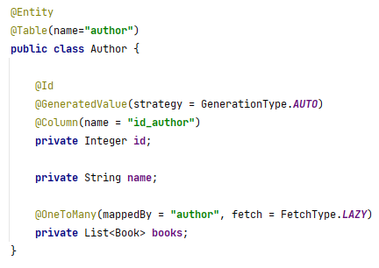
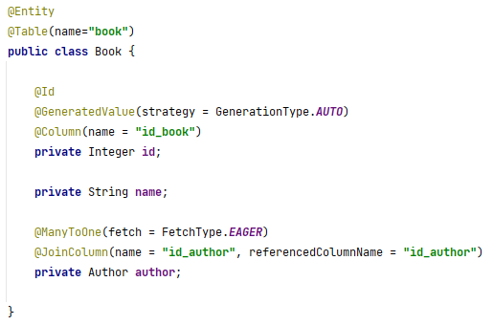
RELACIONAL PARADIGM X JPA
*ToOne
By default: fetchType EAGER
*ToMany
By default: fetchType LAZY

Slide 8
LAZY LOADING X EAGER LOADING
Lazy Loading
Delaying load or initialization of resources or objects until they are actually needed.
Example: Apps with ‘list x detail’ pages.
Eager Loading
Will retrieve all the data once the code is executed.

Slide 9
LAZY LOADING X EAGER LOADING
book table
Id_book (PK) | name | Id_author
1 | Inside the Shadow | 4
2 | The Hollow Veil | 5
3 | Ladders of Love | 6

Slide 10
LAZY LOADING X EAGER LOADING
book table
Id_book (PK) | name | Id_author
1 | Inside the Shadow | 4

Slide 11
LAZY LOADING X EAGER LOADING
book table
Id_book (PK) | name | Id_author
1 | Inside the Shadow | 4
author table
Id_author (PK) | name
4 | Jonas Sanders

Slide 12
QUERY WITH JPA
Criteria
Higher-level. Used in inherited operation.
JPQL
JPA Query Languange. Very close to the SQL Language.
SQL
Structured Query Language.

Slide 13
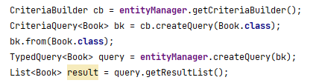
QUERY WITH JPA
Criteria
More Abstraction
Uses the structure defined in the Entities as a Road Map to create the Queries
JpaRepository

Slide 14

QUERY WITH JPA
JPQL
SQL ‘Look-a-like’
Projection

Slide 15
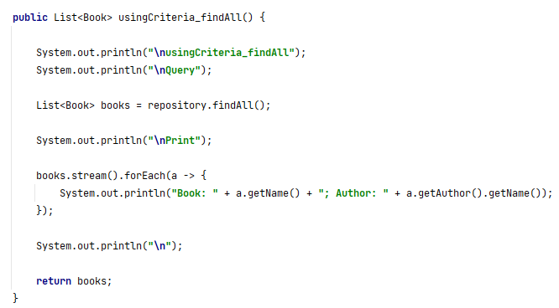
SCENARIO 1 – CRITERIA + FETCH TYPE EAGER

Slide 16
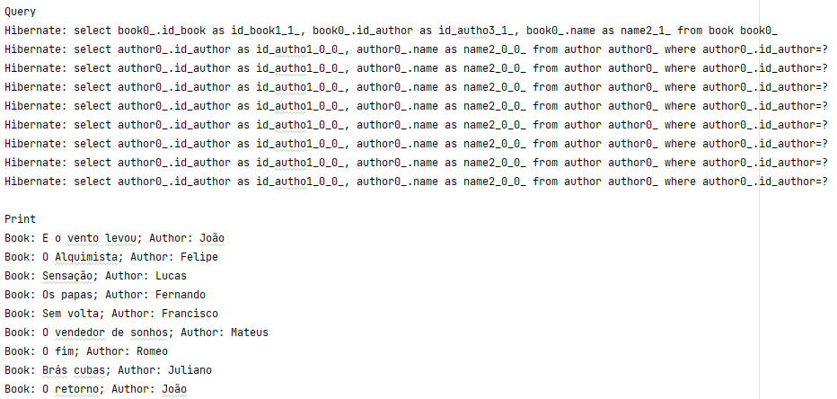
SCENARIO 1 – CRITERIA + FETCH TYPE EAGER

Slide 17
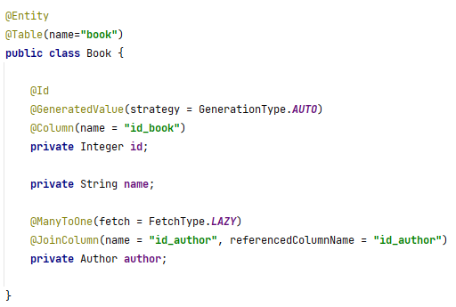
SCENARIO 2 – CRITERIA + FETCH TYPE LAZY

Slide 18
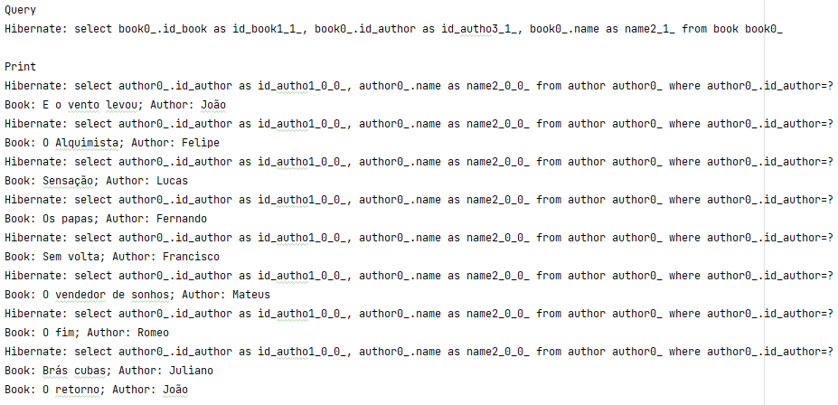
SCENARIO 2 – CRITERIA + FETCH TYPE LAZY

Slide 19
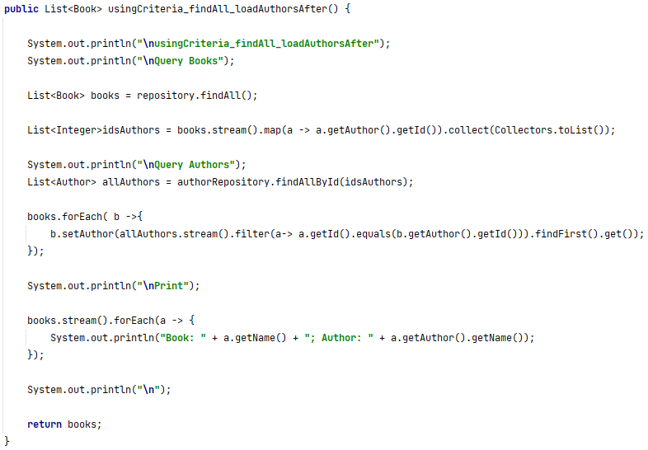
ALTERNATIVE SOLUTION 1 - CRITERIA

Slide 20
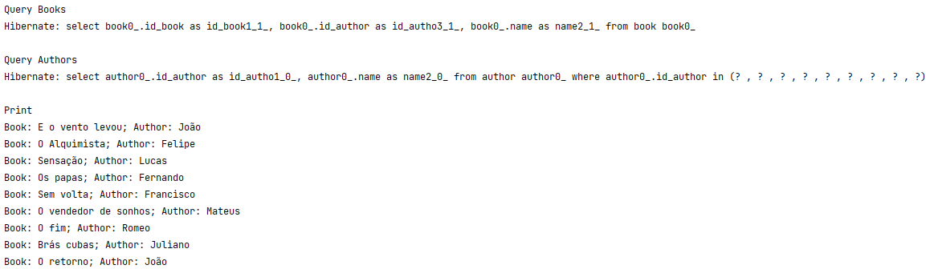
ALTERNATIVE SOLUTION 1 - CRITERIA

Slide 21
ALTERNATIVE SOLUTION 1 - CRITERIA
Positive Points
Access to the DB reduced to 2 Queries.
If it is the main query, it won’t affect the COUNT or PAGINATION.
Using the JPA, it still uses the inherited query (findAll)
Negative Points
The need to post process the attributes to the second Query and back again to Book list (Code complexity)
More than one database access.
IN Clauses in the majority of databases has a limit (For example: In PostgreSQL is 1000)

Slide 22

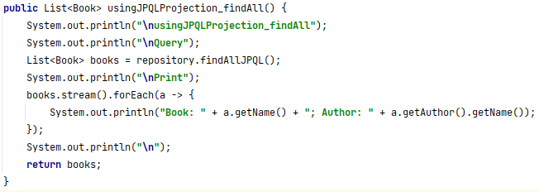
ALTERNATIVE SOLUTION 2 - JPQL

Slide 23
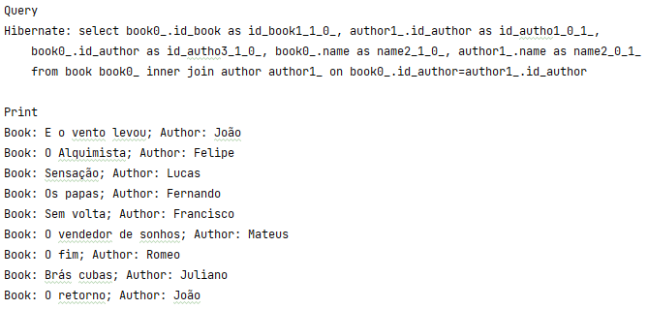
ALTERNATIVE SOLUTION 2 - JPQL

Slide 24
ALTERNATIVE SOLUTION 2 - JPQL
Positive Points
Just one access to the database.
Simple sintax and low code complexity
Negative Points
It is not supported by the current pagination structure
Specifications in criteria can’t be used.
The code search by reference would be affected. Would be necessary to search for text.

Slide 25
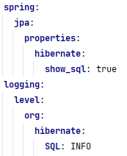
GOOD PRACTICES
Enable log operations in JPA (Change INFO to DEBUG).
Harmful Query behaviors are easily detected.
Using the amount of data as close as possible to the Production environment.
Look for simplicity and low maintenance.
Trade-offs will happen.
To higher perfomance, build SQL Queries
Creating indexes can be necessary to decrease the queries time.

Slide 26
QUESTIONS? THANK YOU!
THIAGO.ADELINO@E-CORE.COM

